Slide 1



Project-I (4IT31)
EXAMVOLT
ONLINE EXAMINATION SYSTEM
Presented by
22IT420 - Keval Buch
22IT460 - Neel Dobariya
22IT455 - Siddhant Rathod
22IT458 - Dhyey Bhanderi
Guided by
Prof. Sherin M. Jijo

Slide 2

DEFINING PROJECT SCOPE AND OBJECTIVES
The Online Examination System automates and secures exams for educational institutions. It enables teachers to create and schedule tests, while students can take them remotely with browser lock, webcam monitoring, and token-based login. Features include AI-driven question generation, auto-evaluation, detailed analytics, result PDFs, and reliability tools like auto-save and test resume. The platform works seamlessly across devices.
The main objectives are to replace paper-based exams with an efficient, transparent, and scalable solution, reducing administrative effort and manual errors. With real-time monitoring and cheating prevention, it ensures exam integrity while offering instant results and performance insights for a secure and user-friendly experience.

Slide 3
MODULES
EXAM MANAGEMENT
TEACHER MANAGEMENT
STUDENT MANAGEMENT
PROCTORED EXAM MONITORING
RESULT MANAGEMENT & ANALYTICS

Slide 4
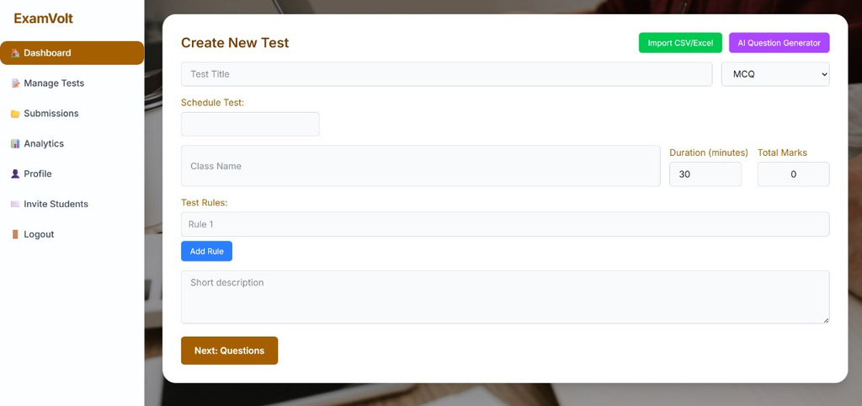
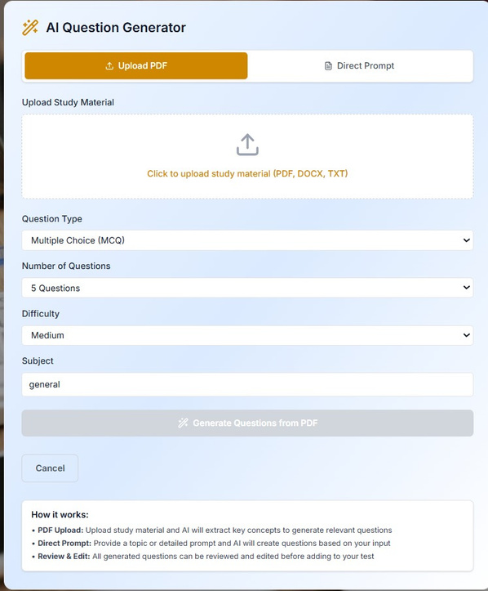
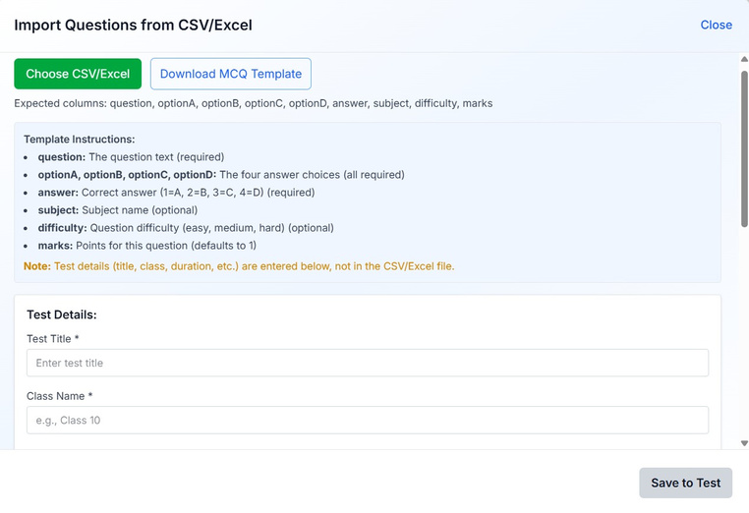
TEACHER MODULE
Teachers can quickly create, title, and schedule new exams, defining essential parameters like class name, duration, total marks, and setting test rules (e.g., MCQ, Coding).
Generate questions instantly by uploading a PDF/DOCX/TXT or using a text prompt. Teachers can easily set the question type (MCQ), difficulty level, and number of questions.
Import large question banks quickly using a CSV/Excel template. This feature supports structured data entry for the question, options, correct answer, subject, difficulty, and marks.

Slide 5
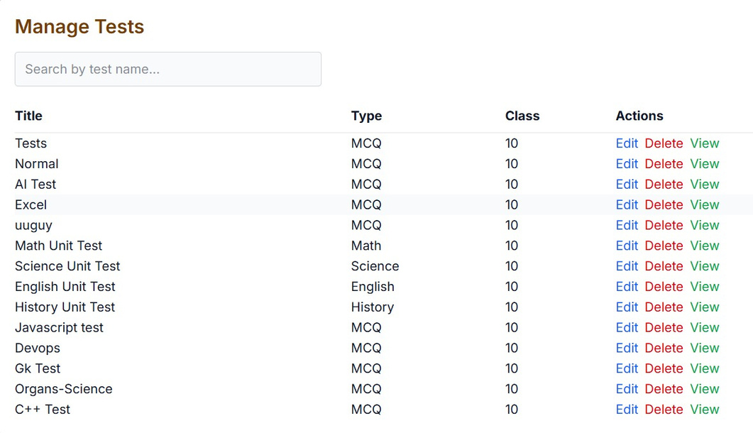
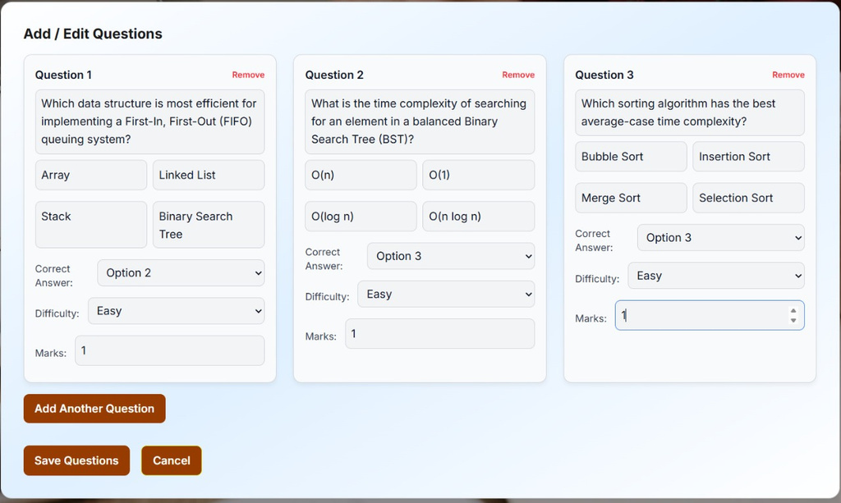
TEST MANAGEMENT DASHBOARD
FLEXIBLE QUESTION EDITOR
Provides a centralized view for teachers to manage all created tests. Quickly see test title, type, and class, with one-click actions to Edit, Delete, or View any test.
Allows teachers to add new questions or modify existing ones within a test. Features include setting the question text, options, correct answer, difficulty level, and marks for each individual question.

Slide 6
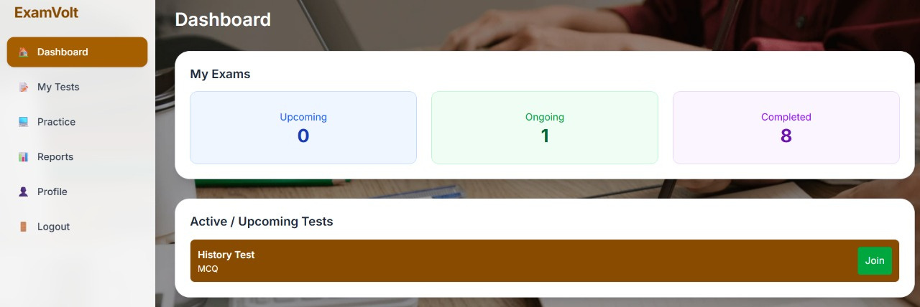
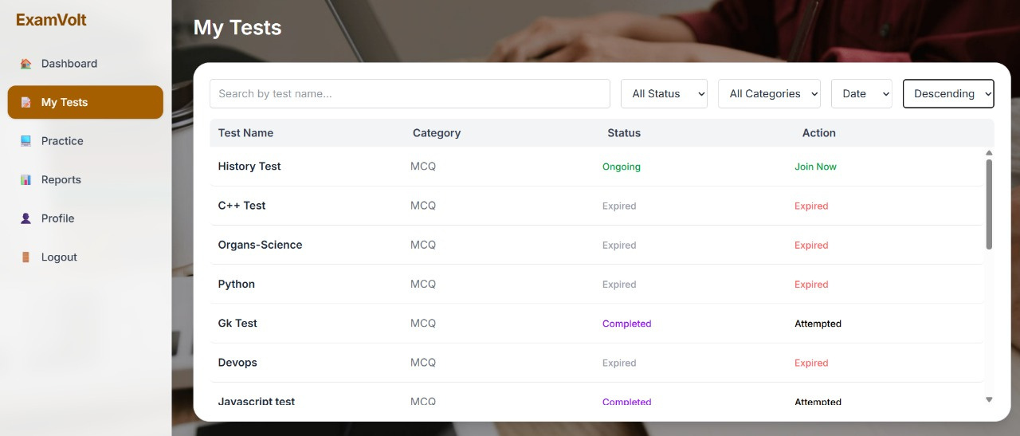
STUDENT MODULE
STUDENT DASHBOARD OVERVIEW
Provides students with a clear summary of their exam status (Upcoming, Ongoing, Completed) and immediately highlights Active / Upcoming Tests they can join, like the 'History Test'.
COMPREHENSIVE 'MY TESTS' LIST:
Students can view a sortable and filterable list of all their exams. They can see the Test Name, Category, Status (Ongoing, Expired, Completed), and the relevant Action (Join Now, Attempted).

Slide 7
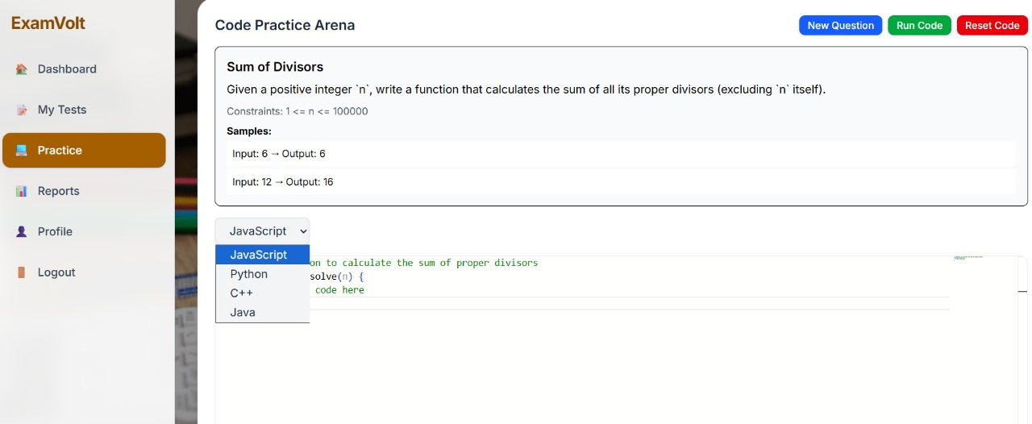
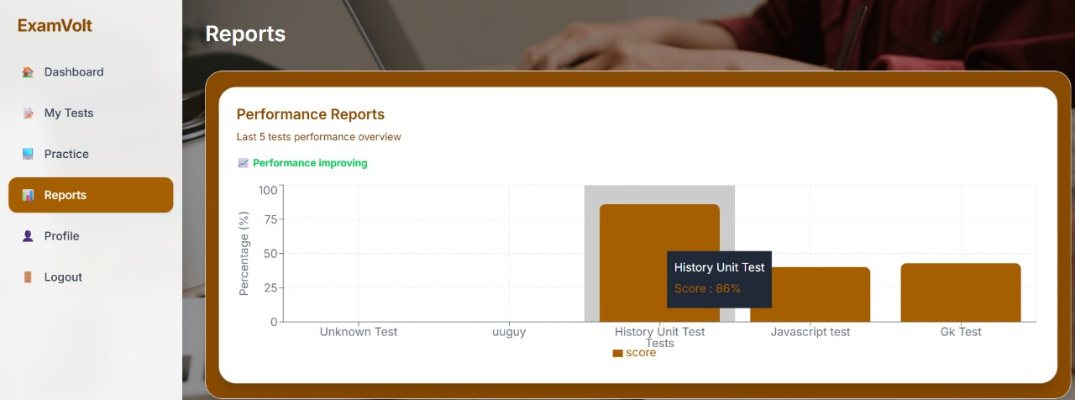
STUDENT PERFORMANCE TRACKING
Provides visual, data-driven performance reports showing an overview of the student's scores (percentage) in their last five tests. It also offers insights, such as "Performance improving."
INTEGRATED CODE PRACTICE ARENA
An environment for students to practice coding challenges (e.g., "Sum of Divisors"). Students can select their preferred language (JavaScript, Python, C++, Java) and instantly Run and Test their code.

Slide 8
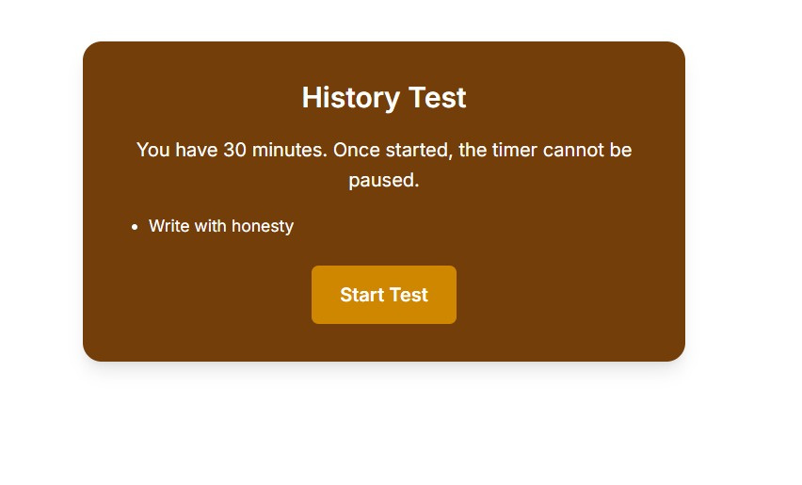
PRE-TEST INSTRUCTIONS
Presents clear rules and constraints to the student before starting the exam. Key information includes the test duration (e.g., 30 minutes), the rule that the timer cannot be paused, and any specific notes (e.g., honesty pledge).
INTUITIVE LIVE TEST INTERFACE
Provides a streamlined environment for taking the exam. Key features include the visible timer, question navigation buttons, a Question Palette showing answer status, and clear details like difficulty level and marks per question.

Slide 9
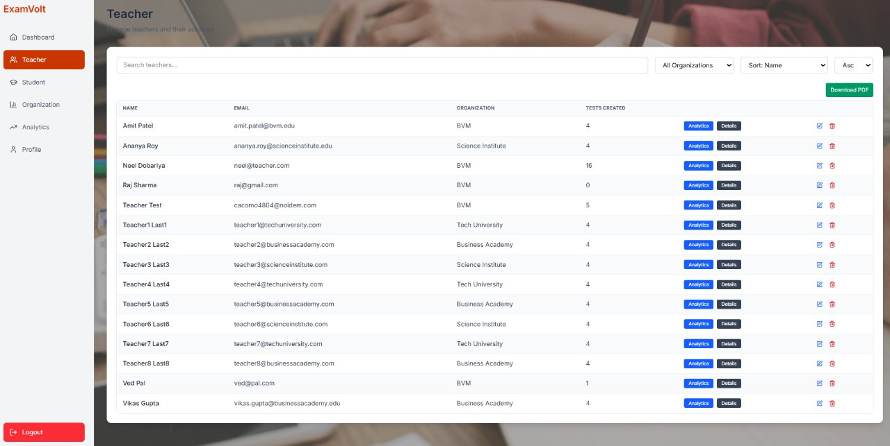

ADMIN MODULE
CENTRALIZED TEACHER MANAGEMENT
Provides the administrator with a high-level overview of system health and activity. Key metrics include Total Users, Total Tests, and a breakdown of Students and Teachers. Visualizations show Tests Created Per Day and User Distribution.

Slide 10
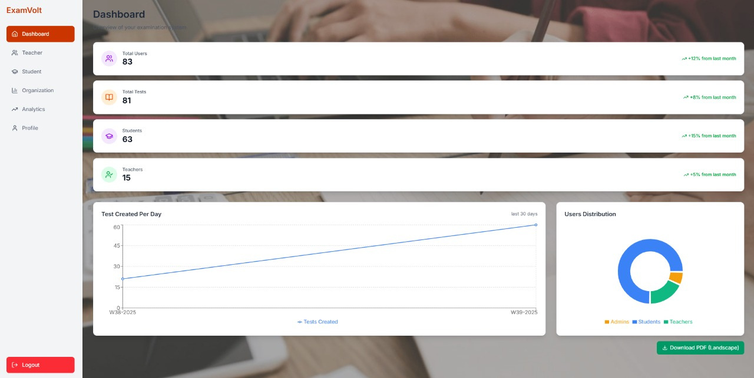
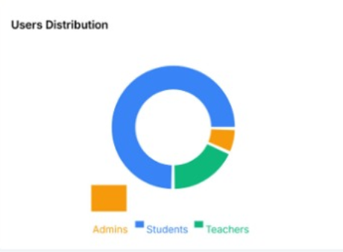
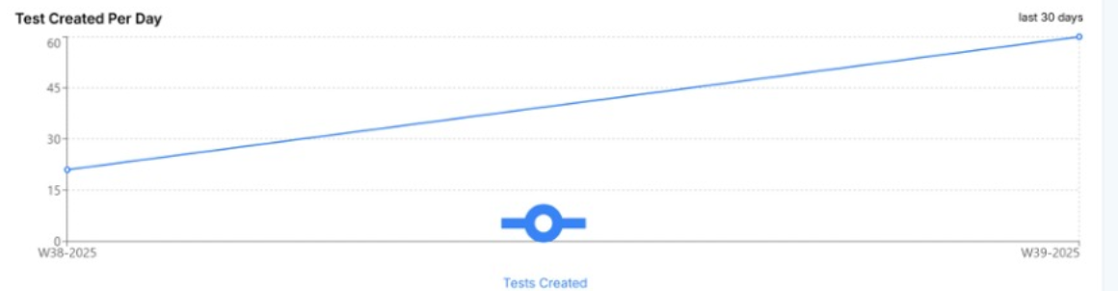
SYSTEM-WIDE ANALYTICS DASHBOARD
Provides the administrator with a high-level overview of system health and activity. Key metrics include Total Users, Total Tests, and a breakdown of Students and Teachers. Visualizations show Tests Created Per Day and User Distribution.

Slide 11
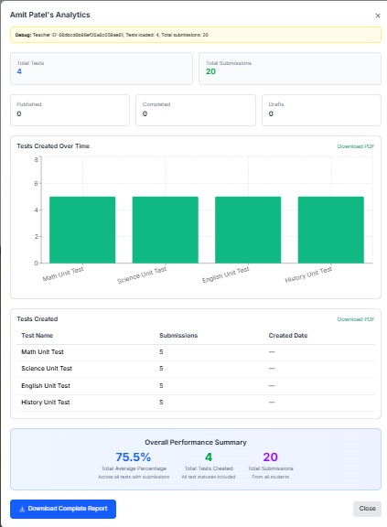
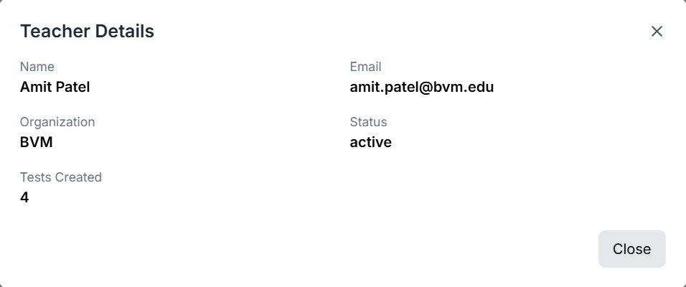
QUICK TEACHER PROFILE VIEW
Displays essential details for a specific teacher, including their Name, Email, Organization, Account Status (e.g., active), and the total number of tests they have created on the platform.
DETAILED TEACHER PERFORMANCE ANALYTICS
Provides a comprehensive overview of a teacher's activity, including the Total Tests created, Total Submissions across all tests, and a breakdown of test statuses (Published, Completed, Drafts). It also visualizes Tests Created Over Time and shows an Overall Performance Summary (e.g., Total Average Percentage) for their exams.

Slide 12

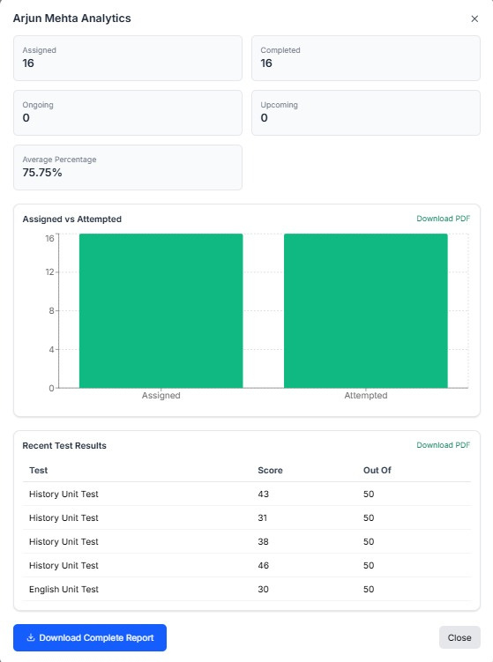
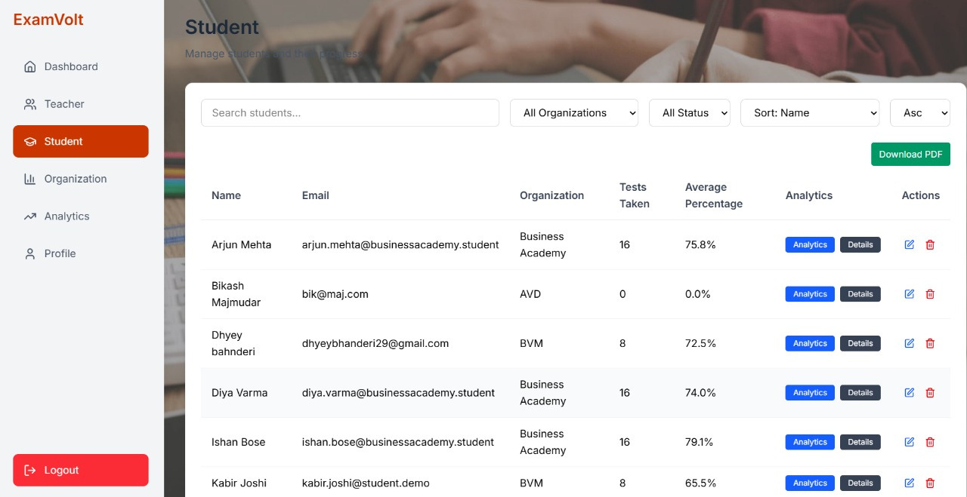

DETAILED STUDENT PERFORMANCE REPORT
Provides an in-depth analytics report for a specific student, summarizing test status (Assigned, Completed, Ongoing, Upcoming) and Average Percentage. Includes visual data on Assigned vs. Attempted tests and a table of Recent Test Results (Score/Total).
CENTRALIZED STUDENT MANAGEMENT
The admin can view and manage a list of all students. Key data points include Name, Email, Organization, Tests Taken, and Average Percentage. Features include search/filter options and action buttons for Analytics and Details

Slide 13
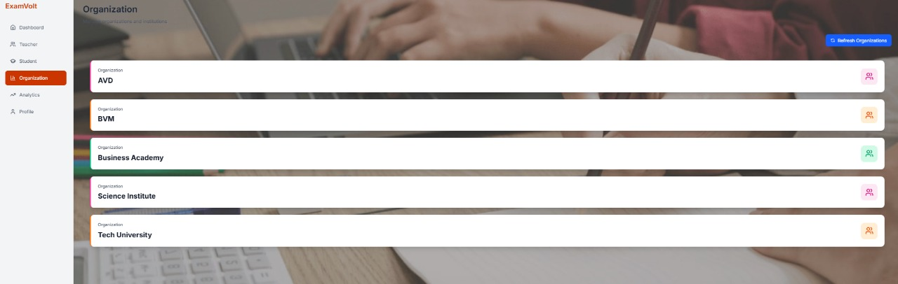

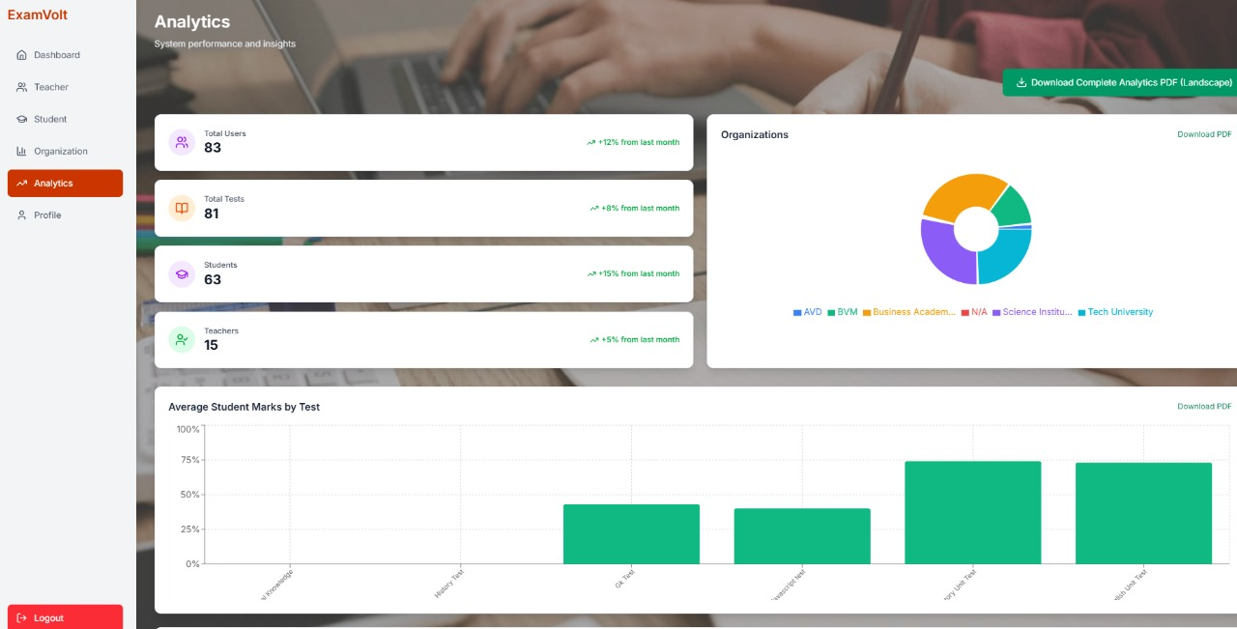
ORGANIZATION MANAGEMENT
The admin can easily view and manage a list of all registered organizations and institutions using the system. This provides a simple, high-level overview of the entire organizational structure.
DETAILED SYSTEM ANALYTICS
A dedicated analytics section providing key metrics (Total Users, Total Tests, Students, Teachers) and visual data on Average Student Marks by Test and a User/Organization Distribution pie chart.

Slide 14
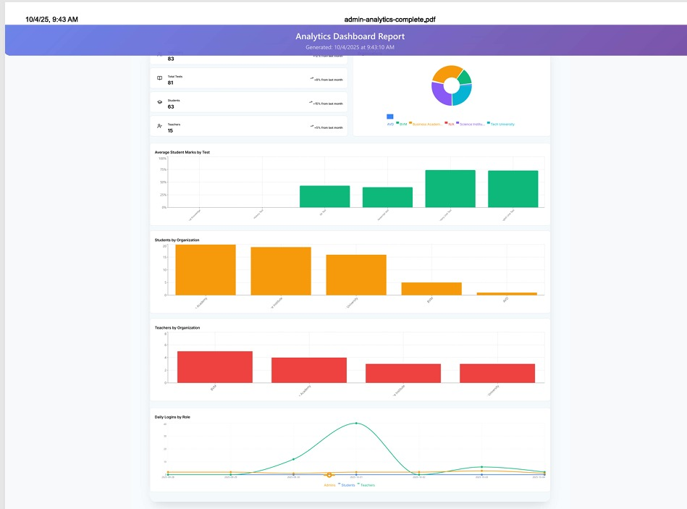

COMPREHENSIVE DOWNLOADABLE REPORT
A complete, printable PDF version of the analytics dashboard, consolidating all system metrics, performance charts (Average Student Marks, User Distribution, Daily Logins), and organizational breakdowns for offline review.

Slide 15
THANK YOU

